Slide 1
Review Session 7
API-201, 11.05.21
Sophie Hill

Slide 2
What are you finding difficult with this week’s material?

Slide 3
Agenda
Review:
PS7 Q3a - do we have one proportion or two?
Sophie’s magic rule for remembering Type I/II errors
Understanding statistical power
Hints for PS8 Q1:
Converting vote share into 2-party vote share
the “coverage rate”

Slide 4
PS7 Q3a
Suppose that you have a sample from the US population indicating, for each person, any cancer diagnosis. Among patients diagnosed with cancer, you would like to test the hypothesis that the fraction of them over 65 is equal to the fraction of them under 65.
Write the null hypothesis in math.

Slide 5
PS7 Q3a
Suppose that you have a sample from the US population indicating, for each person, any cancer diagnosis. Among patients diagnosed with cancer, you would like to test the hypothesis that the fraction of them over 65 is equal to the fraction of them under 65.
Write the null hypothesis in math.
This looks like a difference-in-proportions...

Slide 6
PS7 Q3a
Suppose that you have a sample from the US population indicating, for each person, any cancer diagnosis. Among patients diagnosed with cancer, you would like to test the hypothesis that the fraction of them over 65 is equal to the fraction of them under 65.
Write the null hypothesis in math.
… but it’s actually a single proportion. Why?

Slide 7
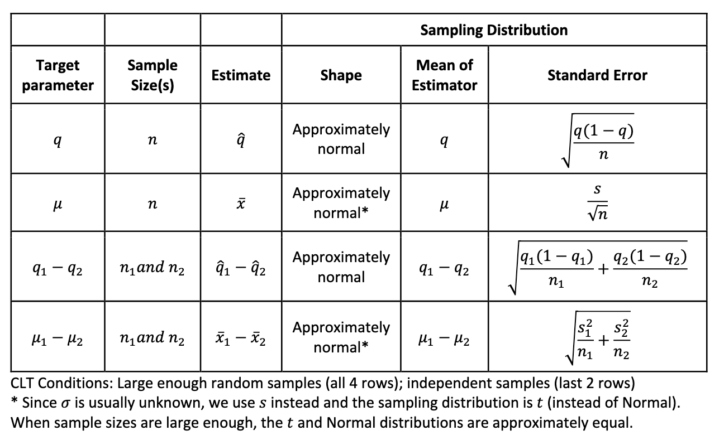

Slide 8
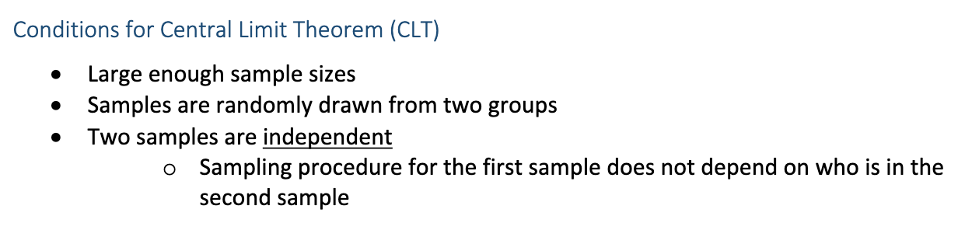
From Handout 15:

Slide 9
PS7 Q3a
Suppose that you have a sample from the US population indicating, for each person, any cancer diagnosis. Among patients diagnosed with cancer, you would like to test the hypothesis that the fraction of them over 65 is equal to the fraction of them under 65.
Write the null hypothesis in math.

Slide 10
PS7 Q3a
Suppose that you have a sample from the US population indicating, for each person, any cancer diagnosis. Among patients diagnosed with cancer, you would like to test the hypothesis that the fraction of them over 65 is equal to the fraction of them under 65.
These two samples are not independent. As the proportion of cancer patients who are 65+ goes up, the proportion of cancer patients who are <65 must go down.

Slide 11
PS7 Q3b
In contrast, in part (b) we did have two independent samples:
You would now like to test the hypothesis that the fraction of people diagnosed with cancer is equal among those aged over 65 than those under 65.
If the rate of cancer among the 65+’s goes up, there is no necessary mathematical implication for the rate of cancer among the <65’s.

Slide 12
Visual interpretation
Over 65’s
with cancer
Over 65’s
w cancer
Under 65’s
w cancer
q₁
q₁
q₂
Over 65’s w/o cancer
Under 65’s
with cancer
q₂
Under 65’s w/o cancer
(a)
(b)

Slide 13
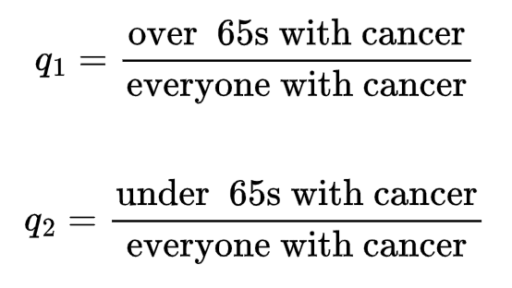
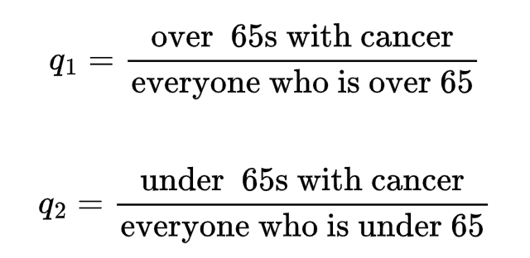
Mathematical interpretation
(a)
(b)

Slide 14
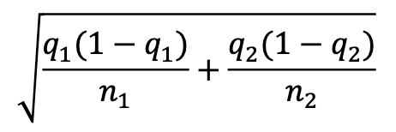
Statistical interpretation
For two random variables X and Y, the variance of the difference, X - Y, is given by:
Var(X-Y) = Var(X) + Var(Y) - 2 Cov(X, Y)
If X and Y are independent, then the covariance, Cov(X, Y) = 0, so Var(X-Y) = Var(X) + Var(Y).
This is where we get the formula for the SE of a difference in proportions:
* We haven’t talked about the covariance before, but you can think of it as being an “unstandardized” version of the correlation coefficient (i.e. not always between -1 and +1).

Slide 15
Statistical interpretation
If X and Y are not independent, then we need to take the covariance into account.
For part (a), the two proportions were complements (i.e., q1 = 1 - q2) and so they must be negatively correlated.
Since the covariance Cov(q1, q2) is negative the variance of the difference q1-q2 is:
Var(q1 - q2) = Var(q1) + Var(q2) - 2 Cov(q1, q2)
...which will be larger than Var(q1) + Var(q2)

Slide 16
Sophie’s magic rule for remembering Type I/II errors
Type I
Type I I

Slide 17
Sophie’s magic rule for remembering Type I/II errors
Type I
Type I I

Slide 18
Sophie’s magic rule for remembering Type I/II errors
Type I ~ False Positive
Type I I ~ False Negative

Slide 19
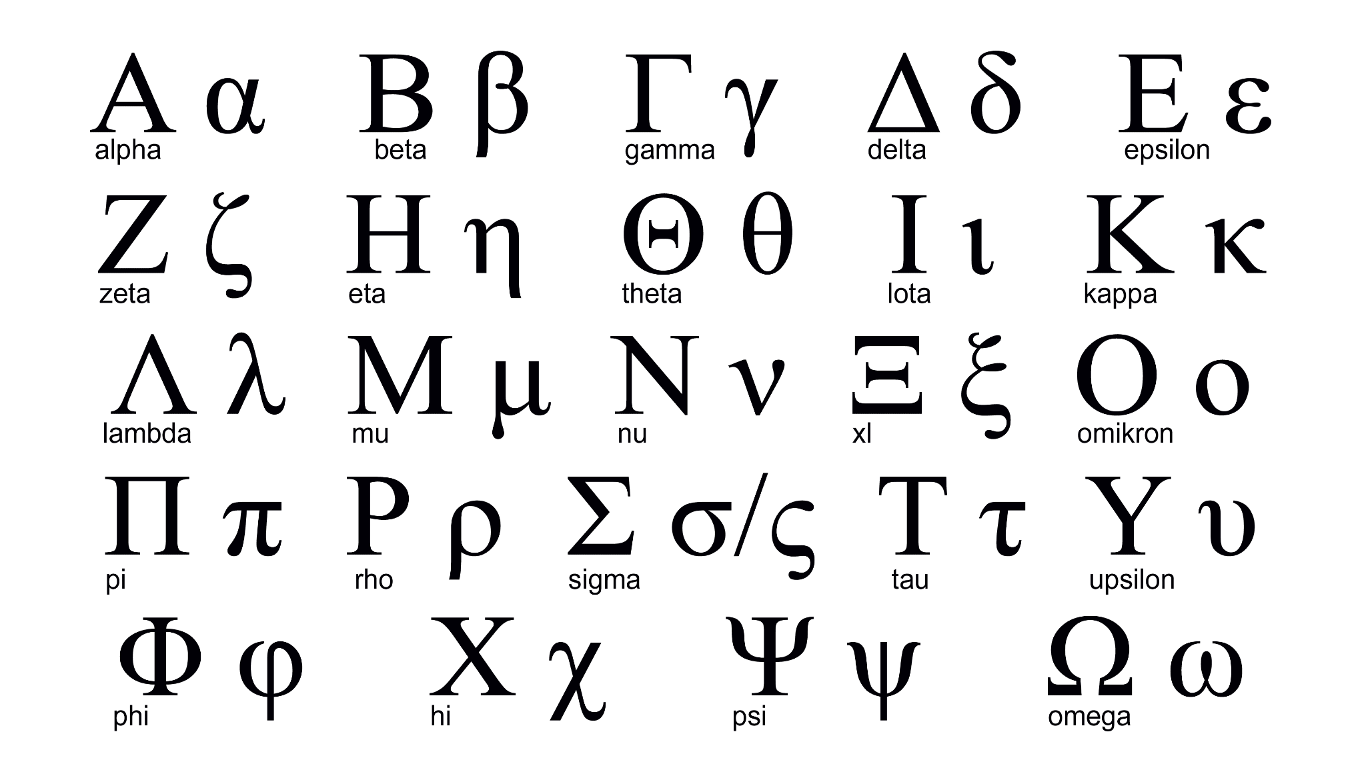
1
2

Slide 20
Sophie’s magic rule for remembering Type I/II errors
Type I ~ False Positive
Type I I ~ False Negative
α = P(Type I error)
𝜷 = P(Type II error)

Slide 21
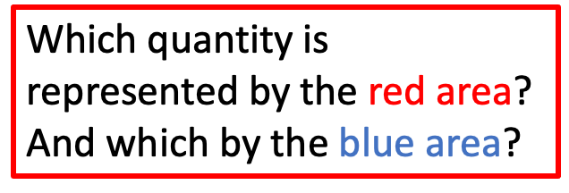
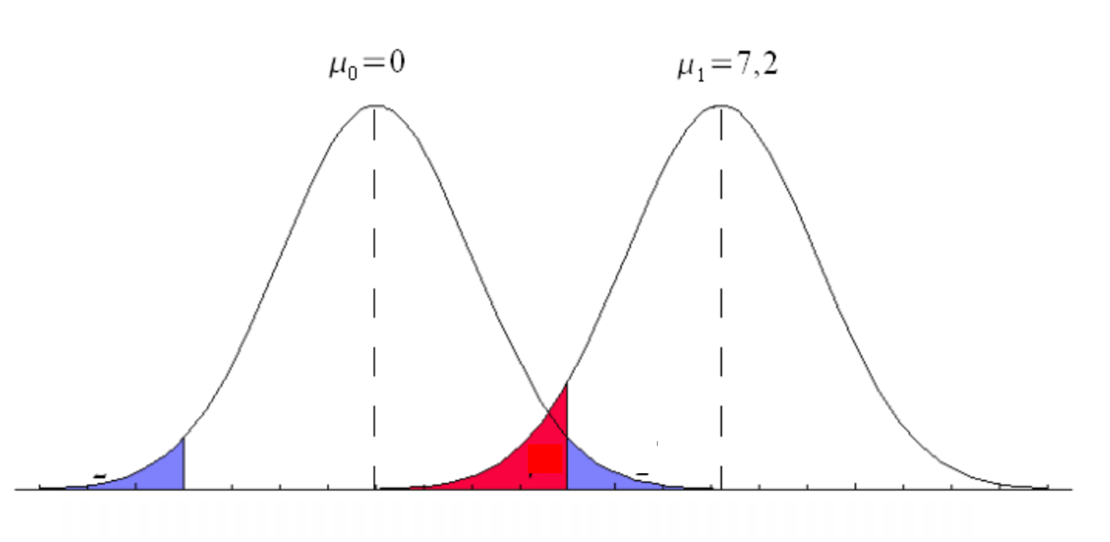
Statistical power

Slide 22
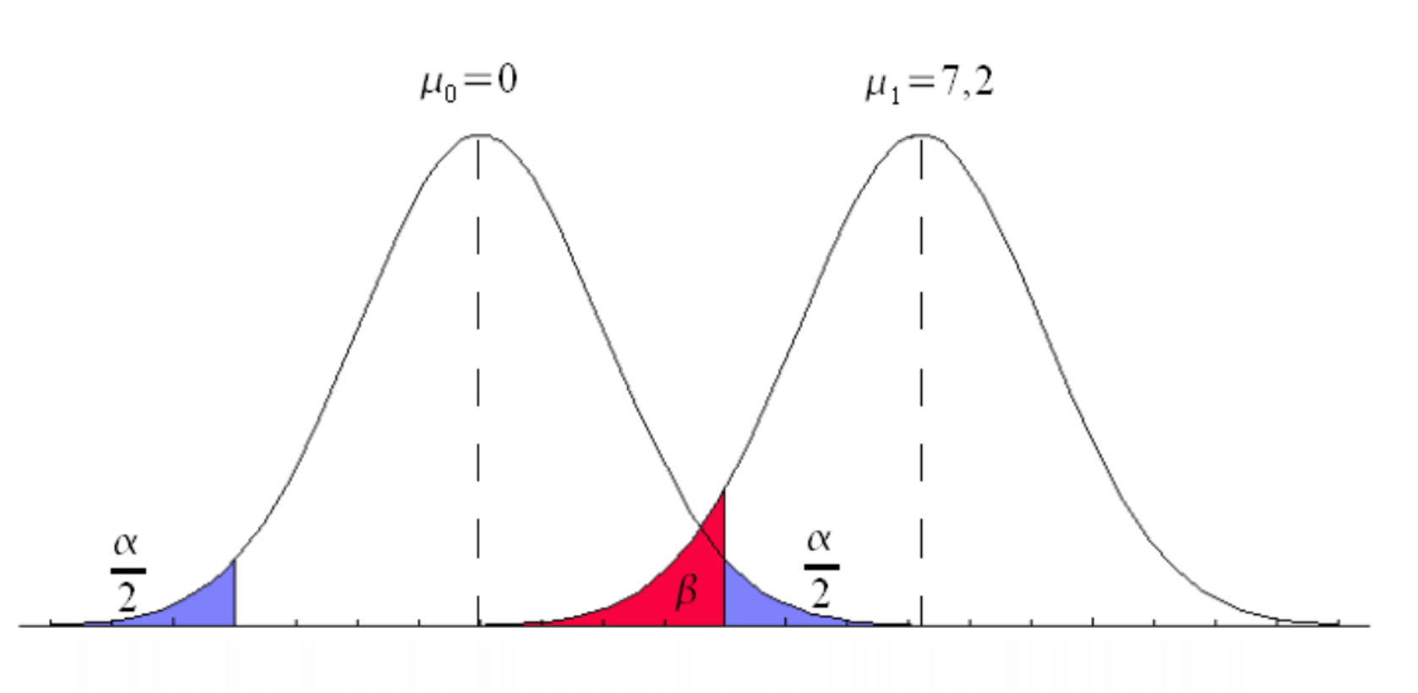
Statistical power

Slide 23
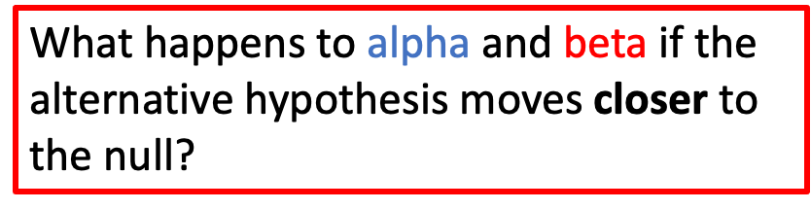
Statistical power

Slide 24
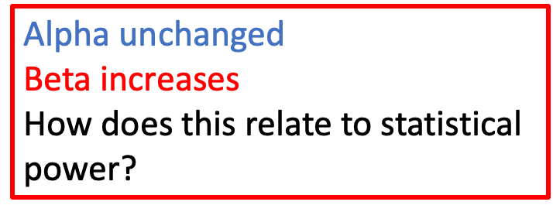
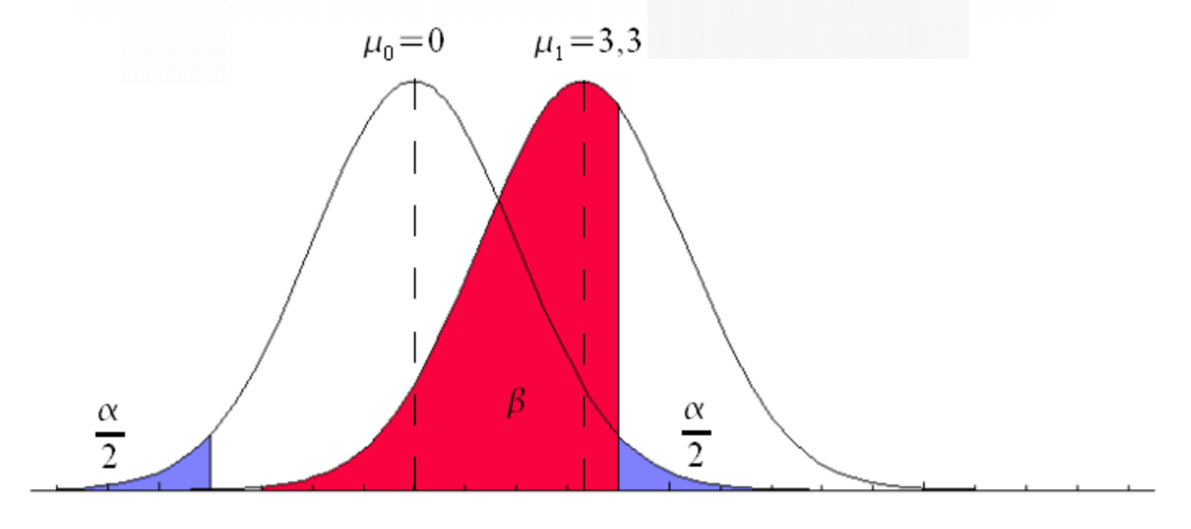
Statistical power

Slide 25
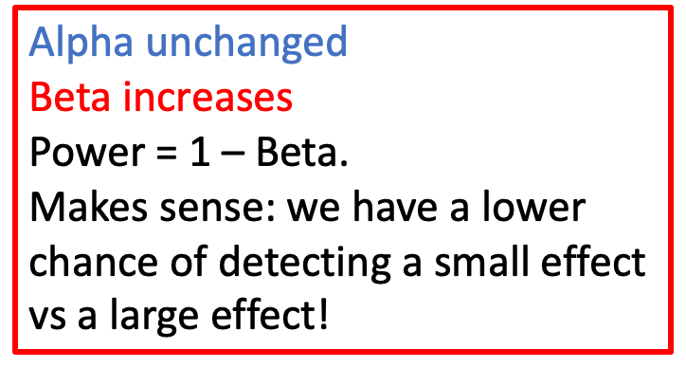
Statistical power

Slide 26
Statistical power
Fill in the blanks! [higher / lower]
Larger sample size means ____ power
Larger effect size means higher power
Larger sample variance means _____ power
Larger alpha means _____ power

Slide 27
Statistical power
Fill in the blanks! [higher / lower]
Larger sample size means higher power
Larger effect size means higher power
Larger sample variance means lower power
Larger alpha means higher power

Slide 28
Key takeaways
Alpha
We can choose whatever alpha we like
To think about alpha, first assume the null, i.e., centre your sampling distribution around the null value
Beta
Beta is determined by our study design and hypothesized effect size
To think about beta, first assume a specific alternative hypothesis, i.e. centre your sampling distribution around an alternative value

Slide 29
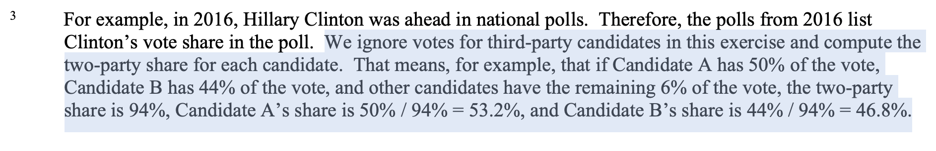
PS8 Q1

Slide 30
PS8 Q1
It makes life much easier to think about US political polls in terms of the 2-party vote share… why?
Now we only have a single proportion to worry about, since q_{d} = 1 - q_{r}

Slide 31
PS8 Q1
It makes life much easier to think about US political polls in terms of the 2-party vote share… why?
Now we only have a single proportion to worry about, since q_{d} = 1 - q_{r}
Life is not so simple in countries with genuine multi-party systems!!

Slide 32
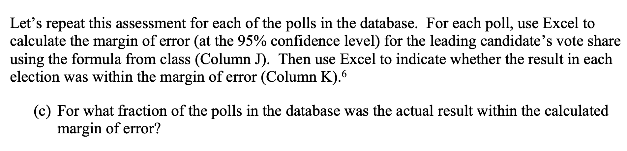
PS8 Q1

Slide 33
PS8 Q1
We call this quantity the coverage rate: how often do our confidence intervals contain the true value?

Slide 34
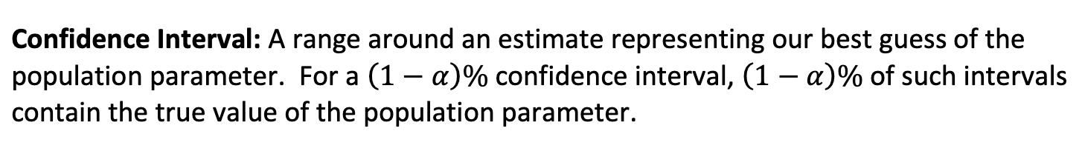
PS8 Q1
We haven’t talked about the coverage rate too often in class, but this concept should already be familiar because it is in the definition of a confidence interval!

Slide 35
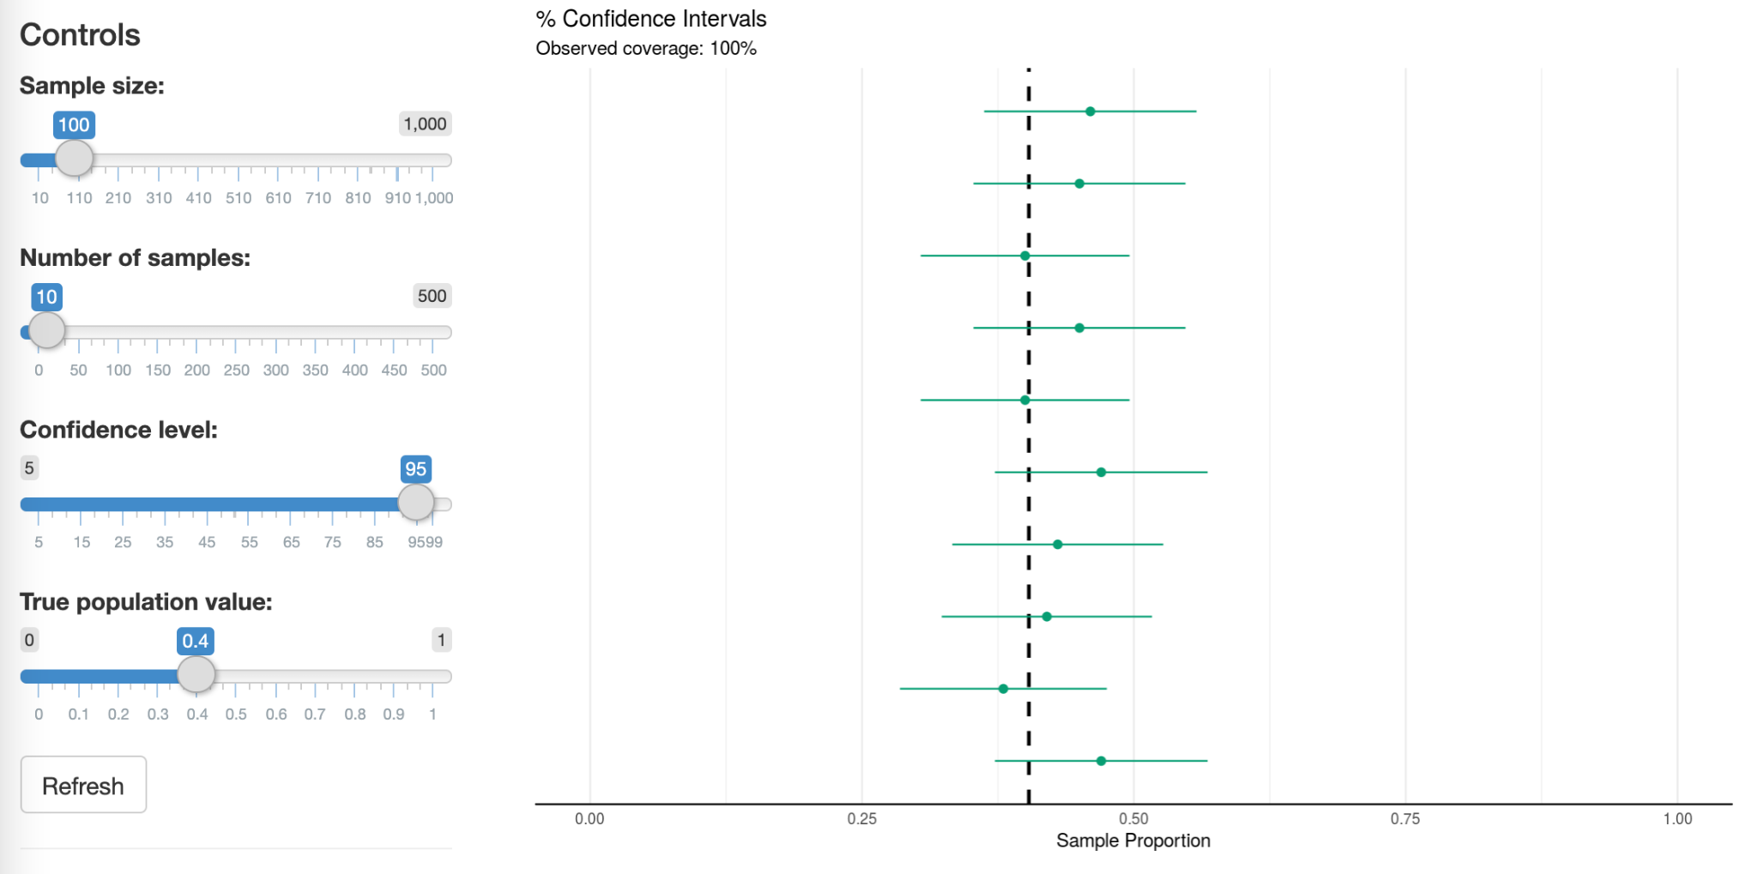
PS8 Q1
Let’s build some intuition!! Go to: https://sophieehill.shinyapps.io/ci-sims/

